Slide 1
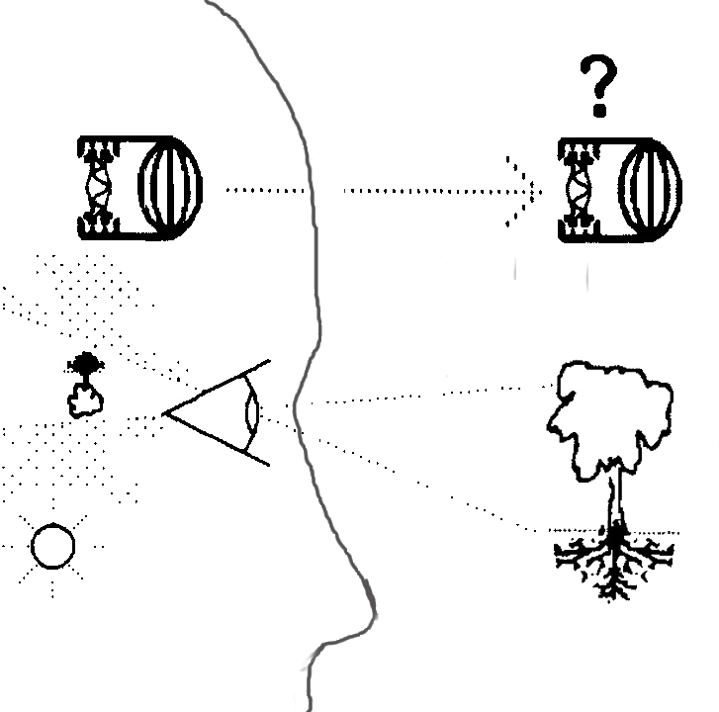
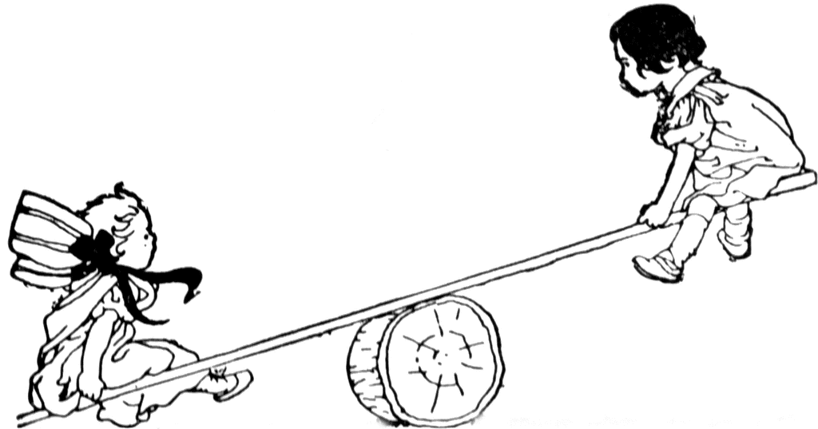

Guiding Patterns of Naturally Occurring Design: Elements A Pattern Language Approach
Viewing things as tailing each other or as out hunting for action?
Back and forth, Creatively Responding to a Partner
HDS systems design science – Slides for PURPLSOC 2015 July 3-5
synapse9.com/signals

Slide 2
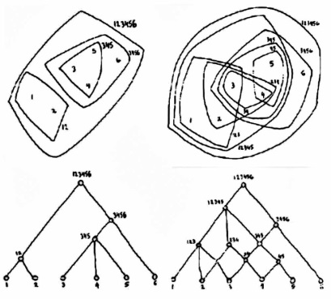
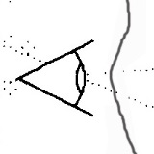

Guiding Patterns of Naturally Occurring Design: Origins
Patterns of Animating Events
Patterns of Animating Environments
Phases of natural growth are irreversible stages of organizational development
Relationships in a living place are complexly overlapping, like a semi-lattice
Jessie Henshaw Physics & Architecture in the 70’s “An Unhidden Pattern of Events” 1979 80’s & 90’s the basic theory, methods & papers Organized wholes as working natural designs developing from seeds |  | Christopher Alexander Math & Architecture in the 60’s “A City is Not a Tree” 1965 A Pattern Language 1977 The Timeless Way of Building 1979 patterns of wholeness in urban and architectural design
HDS systems design science
synapse9.com/signals

Slide 3
Guiding Patterns of Naturally Occurring Design: A Model for Object Oriented for Science
Nature is full of organizations of whole individual things,
that science has never had a way to study,
either as organizations or as individuals
Science has relied on studying external numeric data,
modeling nature as equations
with variables co-determined in fixed relationships.
A pattern language approach to defining objects of nature
would allow study of the objects of nature as wholes
and their otherwise invisible internal designs
HDS systems design science
synapse9.com/signals

Slide 4
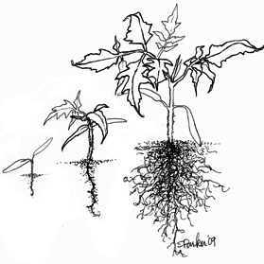
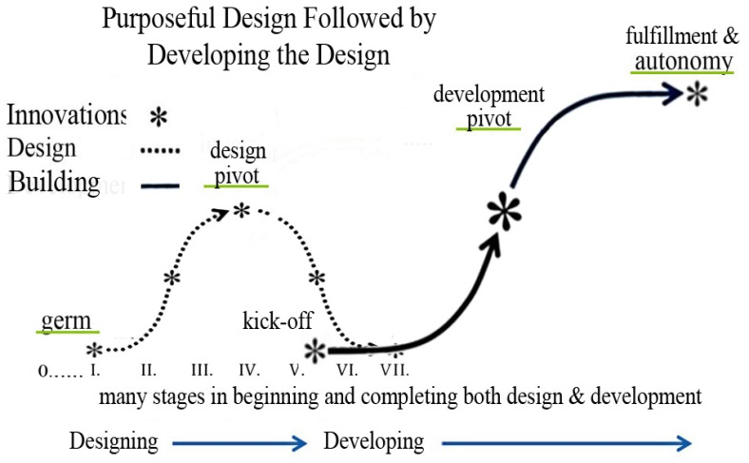
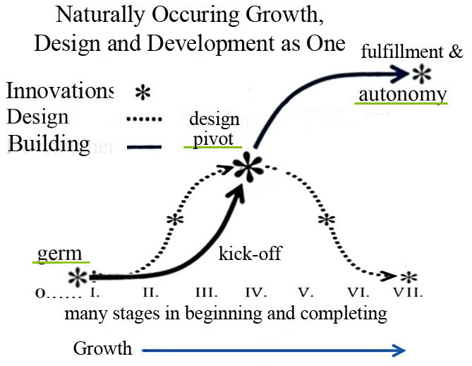
Guiding Patterns of Naturally Occurring Design: Comparing Design Before and During Implementation
The Process of Purposeful Design
The Process of Natural Design
Stages of
Emergence &
Development
to Fulfillment,
in Autonomy
Life
& Aging
The organization
to multiply your energy
and make good use of it
Design Before Development
Design During Development
HDS systems design science
synapse9.com/signals

Slide 5
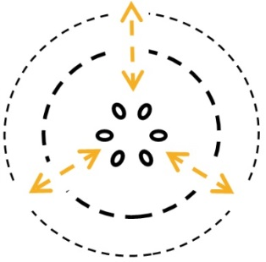
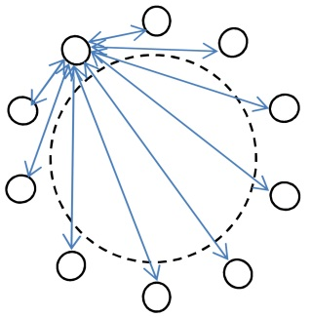
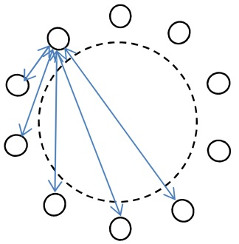
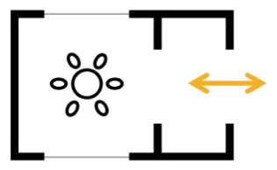
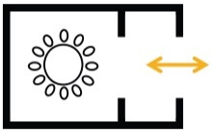
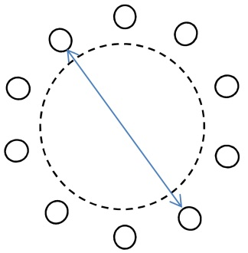
Guiding Patterns of Naturally Occurring Design: Home as a Private World of Equitable Relationships
The General Pattern of Homes
Equitable Connections
An enclosure for a culture’s own design for living
With access to the world
And a near environment or “niche” that marks its domain
A Family Home as a private Commons
A private way of living needing a private commons
Access to the world and public commons
A Community Home as a Public Commons
The Town Hall,
A Community Center for a public family
HDS systems design science
synapse9.com/signals

Slide 6

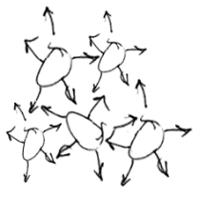



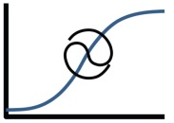
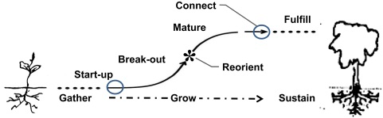
Guiding Patterns of Naturally Occurring Design: Templates for Recording Design Patterns
A Template for Design Pattern Writing
1. Description of Intent
Name | Context | Forces
Image | Problem
 | Solution
Subject | Actions | Results
Expressive name and picture
Concept statement
The place and the forces at issue
Statement of the problem and solution
Steps to take and results to confirm
2. Pattern of Natural Organization & Forces
• Interiors • • Exteriors • • Distant • • Balance •
A Template for Natural Pattern Writing
Name type | Problem Boundaries & Scales | Forces Resilience & Animation
Image | Context – Arrangements of : Centers Roles & Stages & Movements
Simplifying Relationships | Object Domain & engagement | Solution Learning process
Links | Results, Tracking, & Adjustments Anticipated Open questions
3. Action & Reaction Cycles
4. Place in the Phases and Events of Change
HDS systems design science
synapse9.com/signals

Slide 7
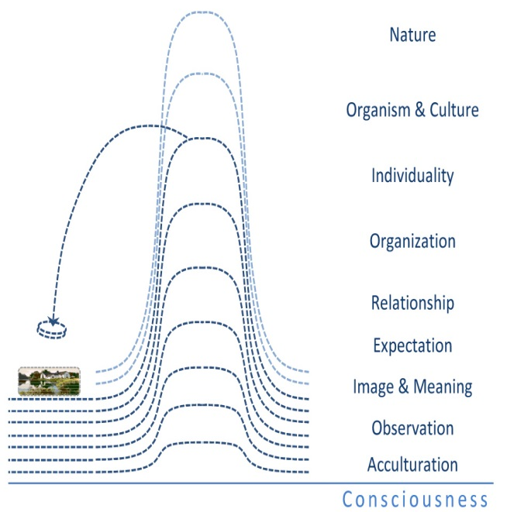
Guiding Patterns of Naturally Occurring Design: General Idea of Natural Pattern Learning: Key Concept
Mental Patterns for finding Natural ones
Equitable Connections
Levels of Natural Pattern Learning
levels of accumulating learning,
a base of biological consciousness
add acculturation & observation
information and experience.
using model patterns at one level
to explore their natural instances,
leading to recognition of patterns at the next level.
As with Argyris’ “Ladder of Inference” (1982), or Maslow's “Hierarchy of Needs”(1943 ), natural pattern learning can correspond to levels of self-awareness, confidence, and higher consciousness
HDS systems design science
synapse9.com/signals

Slide 8
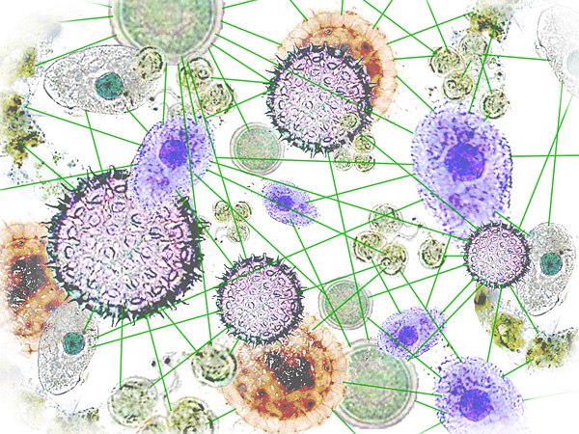
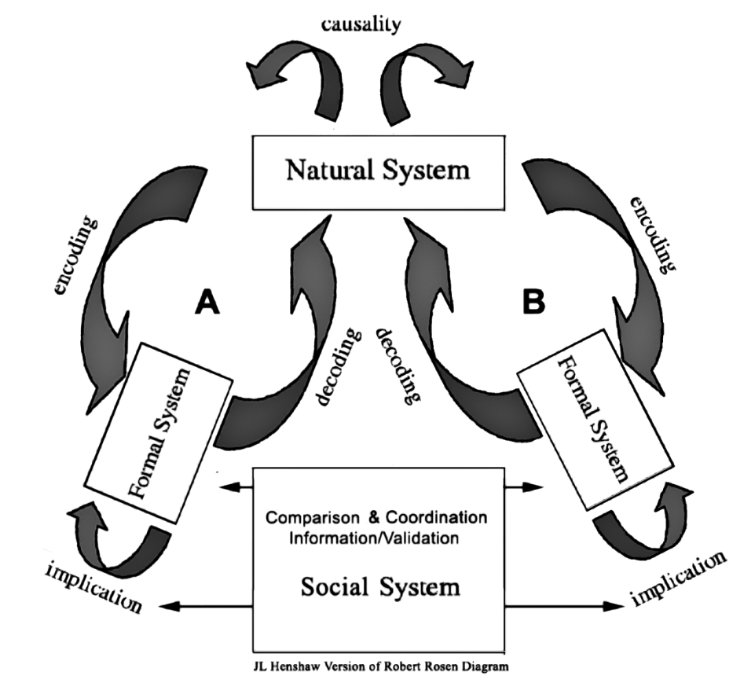
Guiding Patterns of Naturally Occurring Design: The Dual Paradigm View of Learning II.
Learners Communicate with Each Other
For faithful translation of patterns from a multiplicity of independent ‘minds’, interest in what is lost in translation is needed.
Much of what’s lost is the inner worlds of independent ‘minds’, read from outside by their defenses, echoes and discards.
Discards become resources with the environment as a “medium of exchange”.
Two human cultures have in common the need to read the same natural world patterns, as “insides read from the outside”.
HDS systems design science
synapse9.com/signals

Slide 9
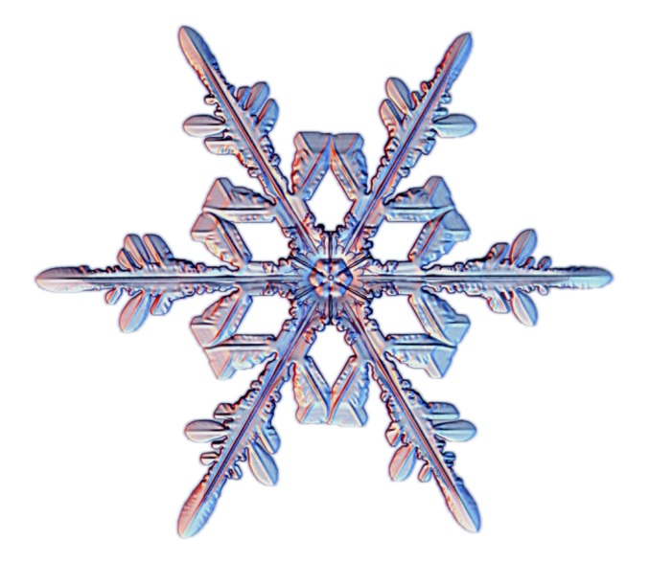
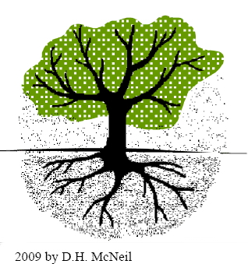
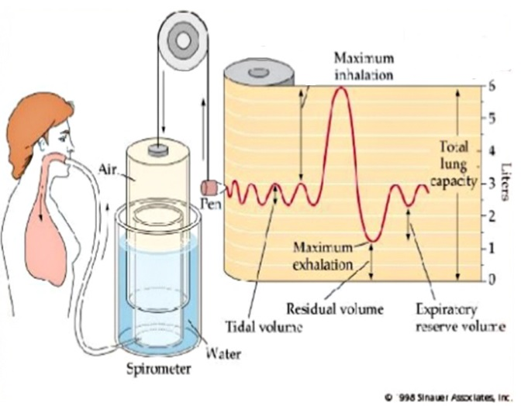
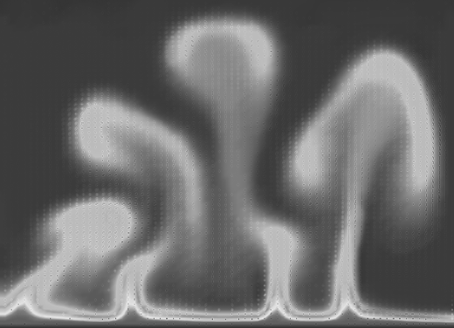
Guiding Patterns of Naturally Occurring Design: Natural Design Patterns
Snowflake
A Plant
What pattern of design Is it that propagates From the point Of each beginning A starting Germ cell Crystallization Eruption Contraction
Air Currents
Breathing
HDS systems design science
synapse9.com/signals

Slide 10
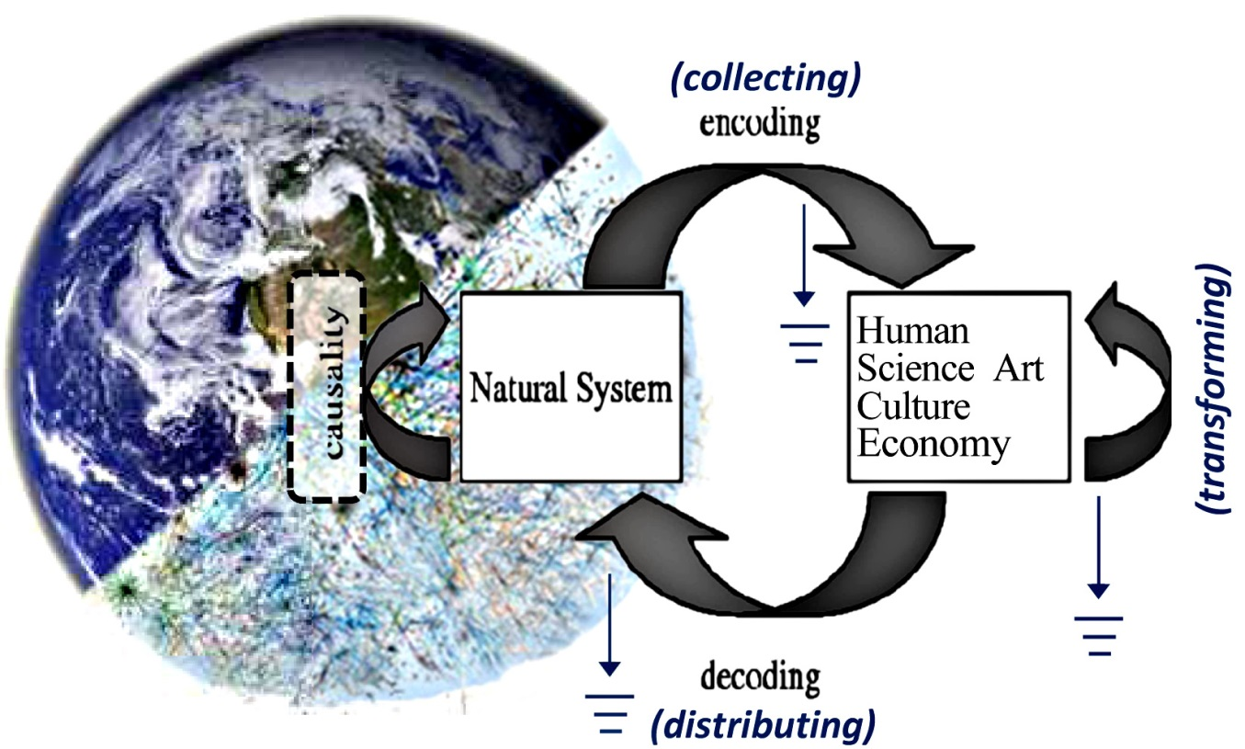
Guiding Patterns of Naturally Occurring Design: The Dual Paradigm View of Learning
Natural World & Learning Systems
Physically Experienced world
Natural patterns converted to mental ones, as collected Materials reused for Art, Science, Culture & Economy,
Various “losses in translation” in ‘collecting’, ‘remaking’, ‘distributing’
The internal design of the human world interprets the internal designs of other natural worlds, by their external appearances
For good translations a sense of what gets lost in translation is needed.
(remaking)
Mentally Experienced Patterns, Conceptual and Behavioral
H. Finidori image of earth & systemic sphere, + adapted Robert Rosen (1991) model of relation of science and nature.
HDS systems design science
synapse9.com/signals

Slide 11
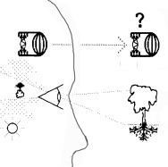

Guiding Patterns of Naturally Occurring Design: Paradigm Bridges used for Pattern Search
Nature and Perception as different worlds – with different designs & languages
Using mental patterns to find related ones in nature to learn from.
Develops a capacity to imagine variations needed to get things to fit well when using them for design.
It teaches you to understand how and why that set of relationships works and is found in its environment, and the natural limits of understanding them
Work & Home as different worlds – with different designs & languages
At work we compete with each other in cooperative groups for serving competitive business goals
At home we bring the money back from work to give away, and traditionally include everyone’s interests in every decision.
HDS systems design science
synapse9.com/signals

Slide 12
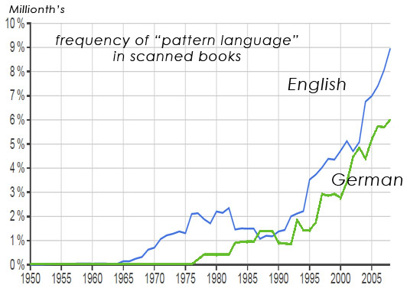

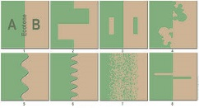
Guiding Patterns of Naturally Occurring Design: Shapes of Change & Boundaries used for Pattern Search
The Emergence of Pattern Language
The early wave of usage for English and German language communities might reflect the original architectural discussion which did not spread globally, with the later continuing growth curve reflecting its leap to other cultures.
Boundaries of Ecological Domains
Neighborhood and cultural boundaries have similar variations in shape to ecological boundaries.
Where you find a boundary, it probably *encircles* a home.
HDS systems design science
synapse9.com/signals

Slide 13
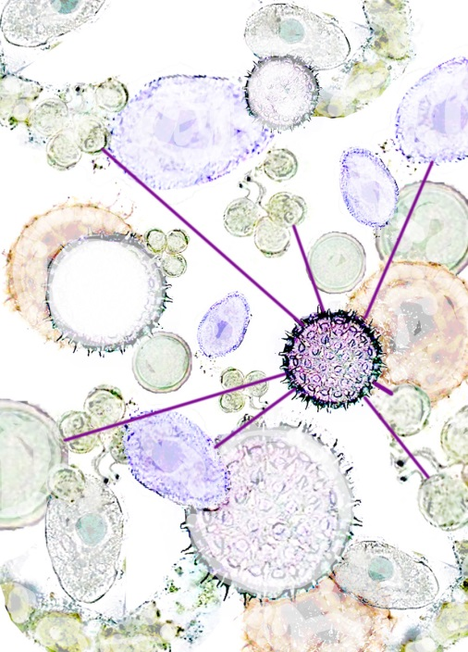
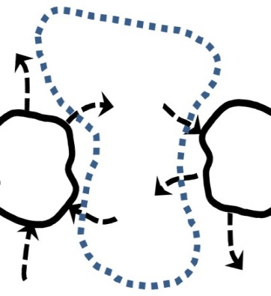
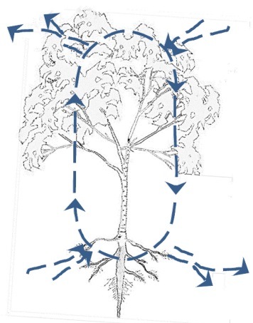
Guiding Patterns of Naturally Occurring Design: Ecological Designs used for Pattern Search
An Ecology of Homes
Visible and Invisible Networks of Homes, With Visible and Invisible Overlapping Connections, Where Perhaps Only the Ones You Relate To Are Visible…
Mediums of Exchange
Common Pools of exchange develop
Circulatory Systems develop
Places where things can be left where they won’t be disturbed are discovered.
Places where things can be left and are taken care of by something else
HDS systems design science
synapse9.com/signals

Slide 14
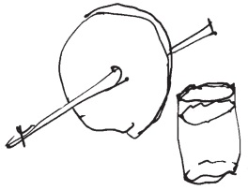
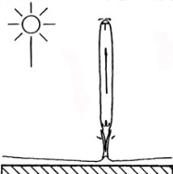
Guiding Patterns of Naturally Occurring Design: Individuality & Emergence used for Pattern Search
Wheel & Axel, Glass & Water
Emergent Combinations Create Individualities
Fitting "useless disks" to "useless axles“ is needed to make “a wheel”, maybe only for their own beauty.
How opposites combine for magical emergent effect is in virtually everything we find useful,
The emergent combination is a “new whole” & “individuality”, replacing the separate parts. So some may ‘see’ only the whole and others only the parts.
Look to the Details For What They Fit Together
It's often a "radical element“, a “misfit” with a secret, breaking the order with a divergent direction, which of course then upsets itself as it must.
With warm air rising, the column breaks away to become an autonomous cell, it’s “birth” as a system.
The calm and the release
HDS systems design science
synapse9.com/signals

Slide 15
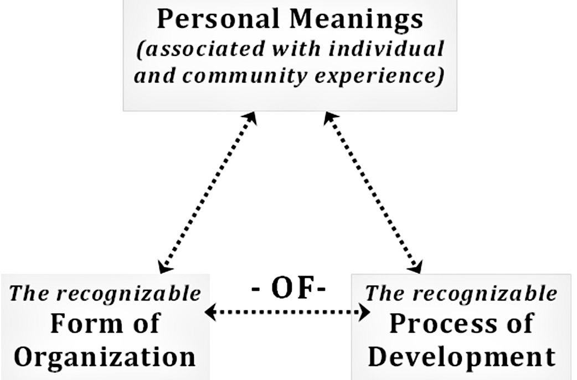
Guiding Patterns of Naturally Occurring Design: Depths of Natural Language used for Pattern Search
1,965 common English words modified by “tion”
Each word has a double meaning, naming the process of transformation and the end state, giving our meanings a “three dimensions”, combining nature’s meanings with our emotional and cultural values.
Words for Transforming States of Being
abbrev.iation: used for both shortening something and the shortened form of it.
acclam.ation: used for the process of making and the end state of what was made
dele.tion: used for both the removing something and the end state of it having been removed.
comm.uni.cation: a common understanding, both the way of reaching it and what was reached.
co.oper.ation: as jointly operating something, both the way of finding how and the way found.
vocal.iz.ation: used to variously mean 1) using the voice for expression, 2)the collection of ways people do that and 3) a particular vocal expression
“OneLook Dictionary” search for “*tion” http://www.onelook.com/?w=*tion&scwo=1&sswo=1
HDS systems design science
synapse9.com/signals

Slide 16
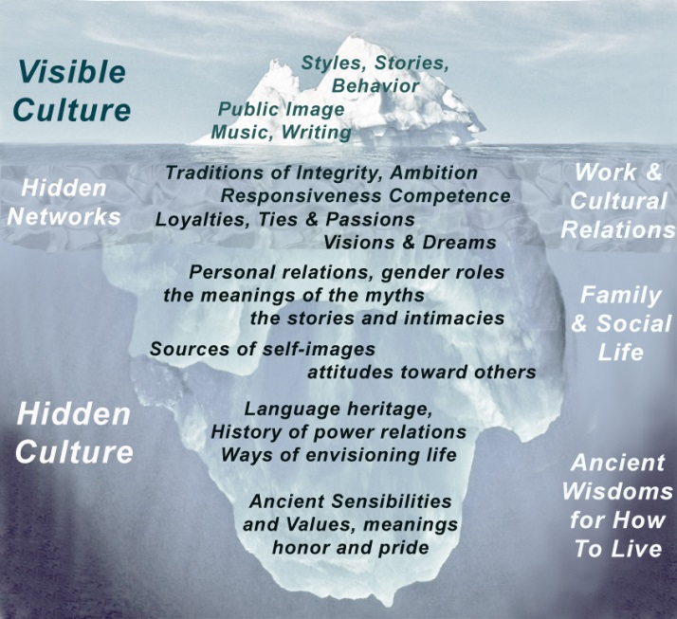
Guiding Patterns of Naturally Occurring Design: Depths of Cultures used for Pattern Search
Above the surface,
Below the surface,
Far Below,
Seen & Hidden Networks with Others
Cultural cues prompt you to ask deeper cultural questions, understanding the common language everyone has for protecting the home of their culture
HDS systems design science
synapse9.com/signals

Slide 17
Guiding Patterns of Naturally Occurring Design: Elements
A Pattern Language Approach
Natural design patterns
The dual paradigm
Nature as a Repository of Designs that Work
Recognizing where they’re needed
Recognizing how they can fit.
To balance the forces
Healing and bringing living quality home
HDS systems design science – Slides for PURPLSOC 2015 July 3-5
synapse9.com/signals

Slide 18



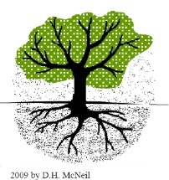
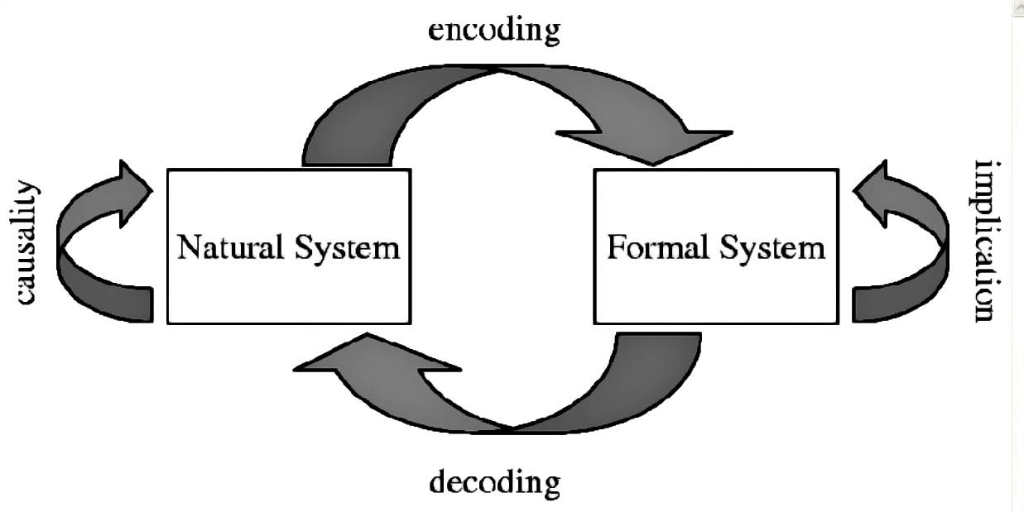

Guiding Patterns of Naturally Occurring Design: Elements
A Pattern Language Approach
Credits
Wikipedia “Ecotone”
Christopher Alexander, from “A City is Not a Tree”
Robert Rosen, 1991 Essays on Life Itself.
Arthur Mee and Holland Thompson, eds. The Book of Knowledge (New York, NY: The Grolier Society, 1912)
2009 Don McNeil Collection
Other Images by JL Henshaw – author: use to comply with Creative Commons license.
HDS systems design science – Slides for PURPLSOC 2015 July 3-5
synapse9.com/signals

